Slide 1





GIN456
MARTIAL ARTS INSTRUCTOR
Presented to Br. Elie Saad
Presented by:
Asif ALAM, 202201934
Antonio HADDAD, 202200238
Karl ROMANOS ABOU JAOUDE, 202200876
Elias-Charbel SALAMEH, 202201047
01

Slide 2
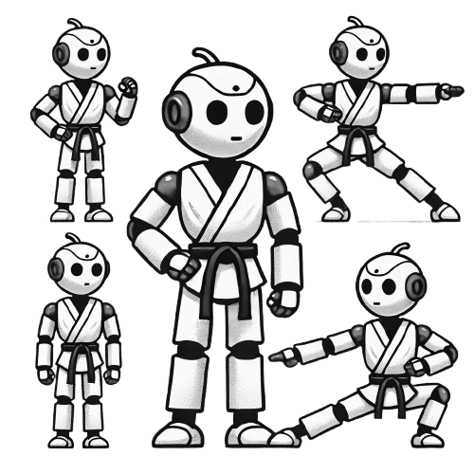
GIN456
INTRODUCING PEPPER:
YOUR MARTIAL ARTS SENSEI
Pepper, our Martial Arts Instructor, teaches basic fighting stances, assesses skill levels, and educates on martial arts history.
She complements the coach, offering personalized attention to students when the coach is busy.
02

Slide 3
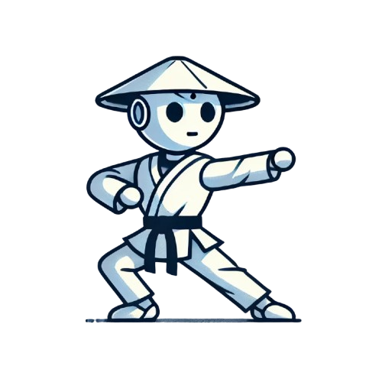
GIN456
WHY MARTIAL ARTS? WHY PEPPER?
Coaches need help managing students of different skill levels.
Pepper assists with basic lessons, allowing coaches to focus on advanced students, while fostering discipline and growth.
03

Slide 4

GIN456
WHAT THIS PROJECT BRINGS
Pepper supports beginner and amateur levels, offering tailored lessons to beginners.
She provides a comprehensive learning experience, blending martial arts education with technology.
04

Slide 5
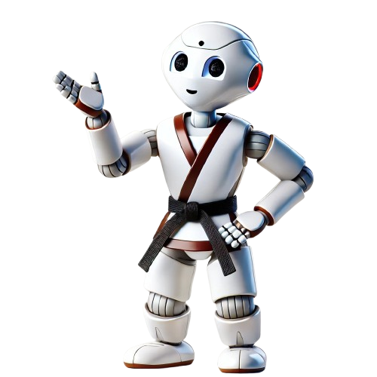
GIN456
UC1 - Initiate Interaction
UC2 - Assess Skills
Use
Cases
UC3 -
Tell a Story
UC4 - Teach Martial Arts
05

Slide 6
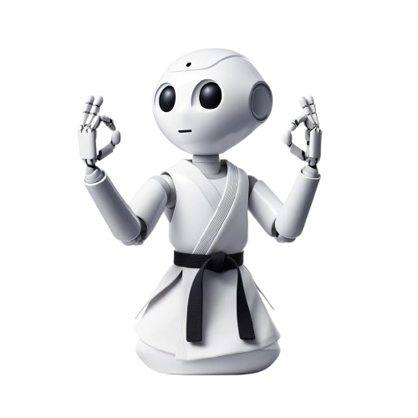
GIN456
UC1-2 Initiate Interaction + Assess Skill
UC3 -
Tell a Story
UC4 - Teach Martial Arts
06

Slide 7
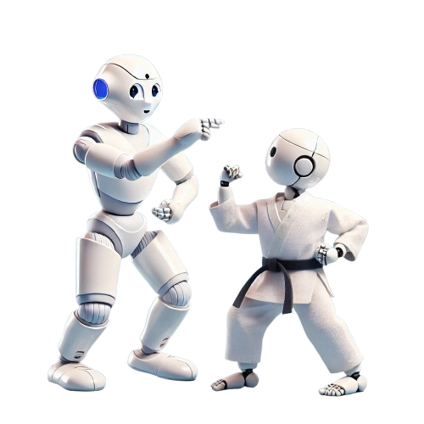
HOME
SERVICE
ABOUT US
CONTACT US
GIN456
Personas
Jack
11
interested in martial arts
eager to learn
07

Slide 8
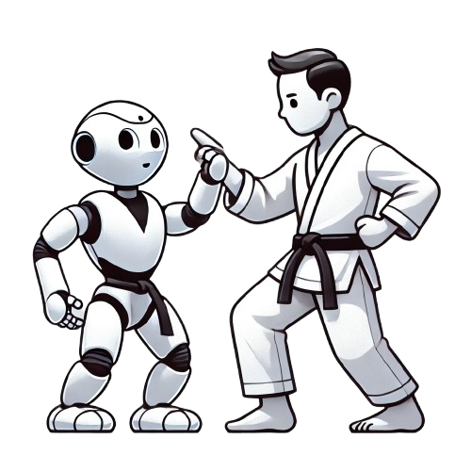
HOME
SERVICE
ABOUT US
CONTACT US
GIN456
Personas
Billy
20
Billy is very introverted and is routinely bullied and ostracized for his social awkwardness
He could greatly benefit from self defense lessons to elevate his confidence and fortify his pugilistic skills
08

Slide 9
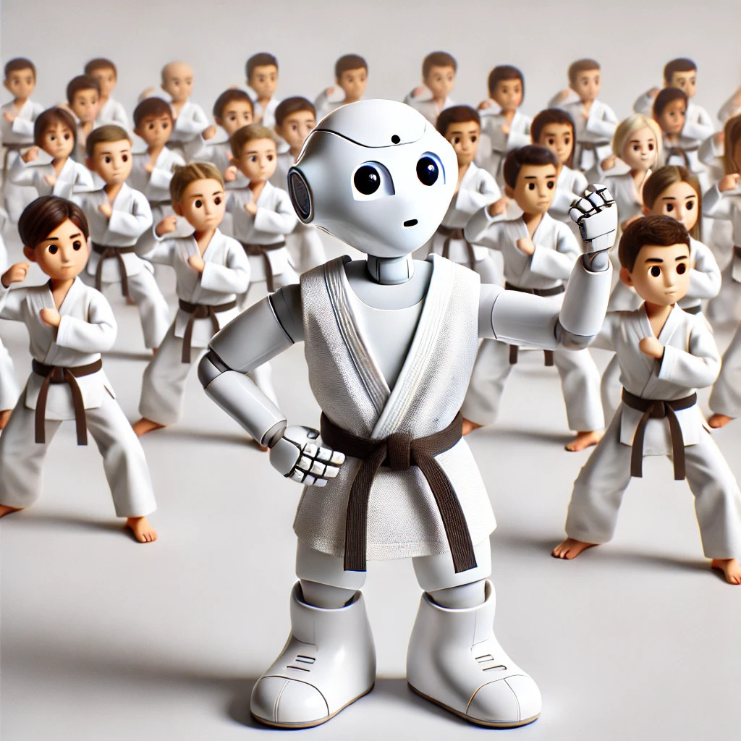
GIN456
WHERE WILL THIS BE USED?
Pepper can be deployed in martial arts schools, youth programs, or fitness centers.
She complements any class by assisting beginners and freeing up coaches for advanced learners.
09

Slide 10
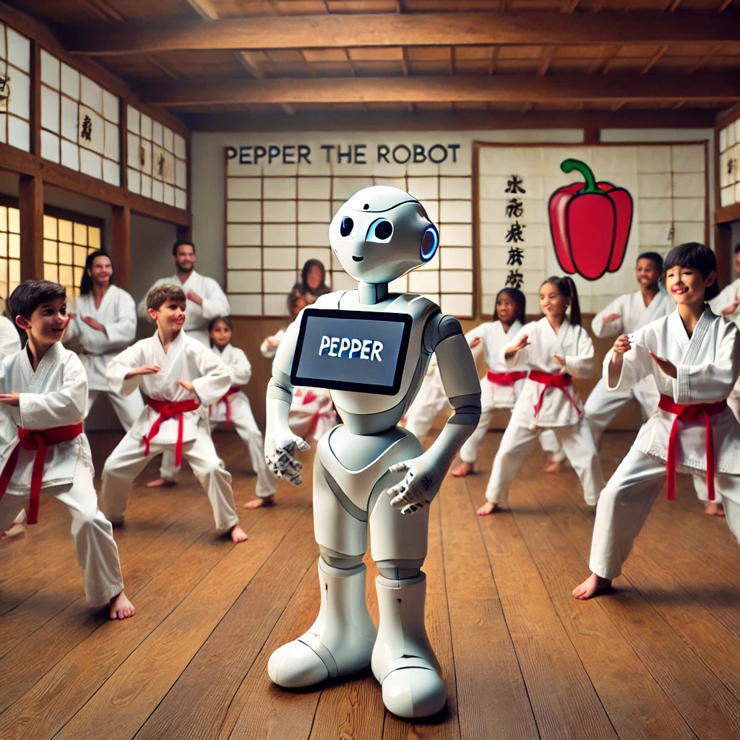
GIN456
WHO CAN BENEFIT?
Pepper is ideal for coaches with mixed-level classes, especially beginners.
She personalizes learning experiences for all students, regardless of skill level.
10

Slide 11
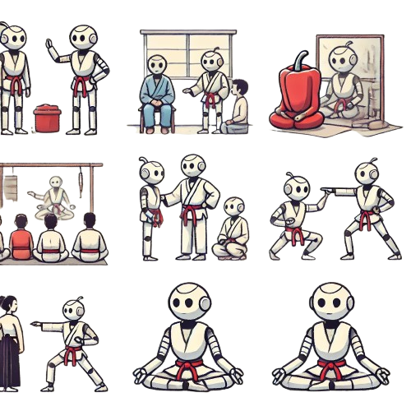
GIN456
A DAY IN THE LIFE OF PEPPER
Pepper greets students, assesses their skill levels, and teaches stances and techniques.
She switches to martial arts history lessons or provides personalized feedback for advanced students when needed.
11

Slide 12
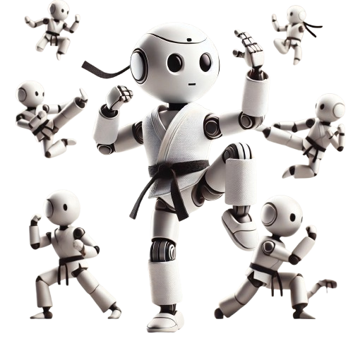
GIN456
CHALLENGES ON THE JOURNEY
We faced challenges in making Pepper understand real-life movements and communicate smoothly with external systems.
However, each hurdle strengthened the project and improved its accuracy.
Integration of the use case behaviors
Running the Model on a our local machine
Synchronization between the python 3 scripts and the choregraph project
Testing continously the input frame
12

Slide 13
GIN456
How AI can boost our product
Through computer vision and the Ultralytics YOLOv8 pose estimation Model (nano)
We take a frame from the feed of the camera installed on Pepper and we process it on our machine
The returned value is a feedback whether the position is correct or not
We have 2 issues to tackle:
- AI model & integration
- SFTP Communication
13

Slide 14
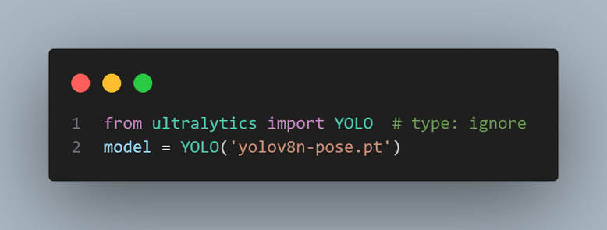
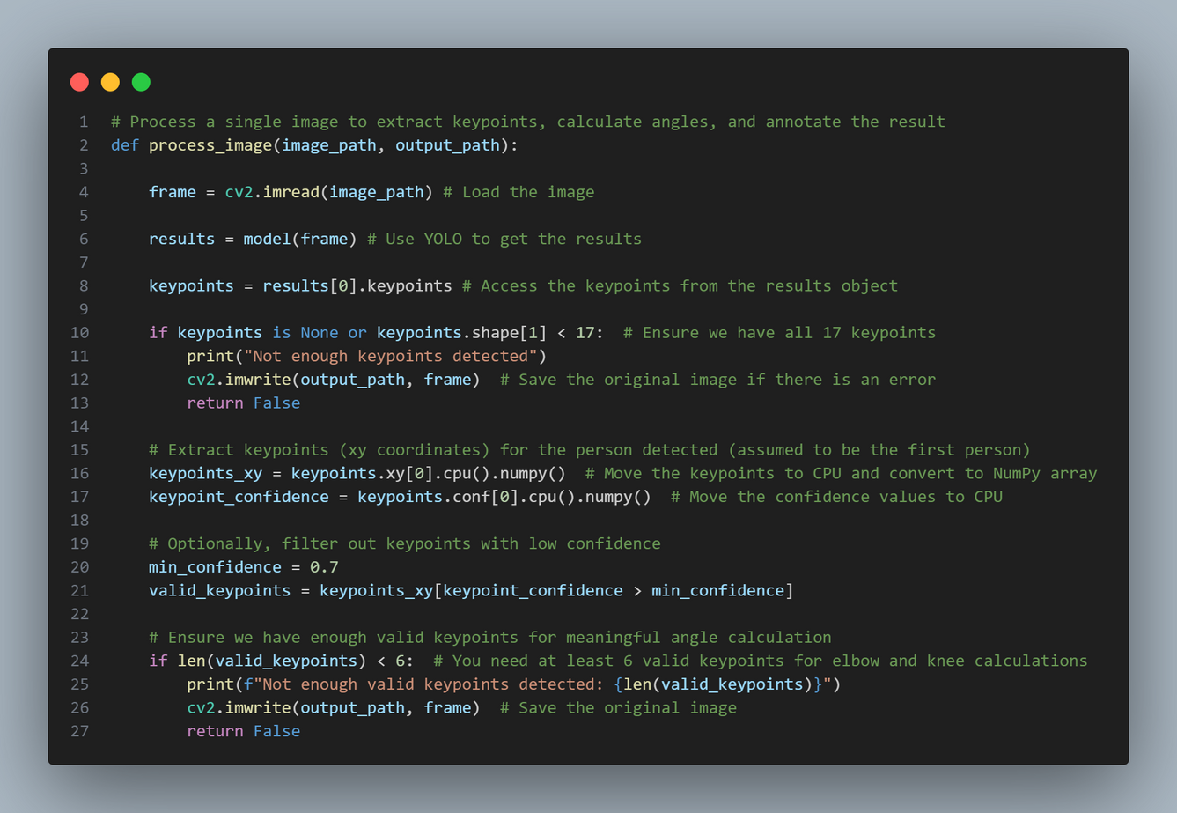
Ultralytics YOLOv8
Nano pose estimation model
Load & Predict
14

Slide 15
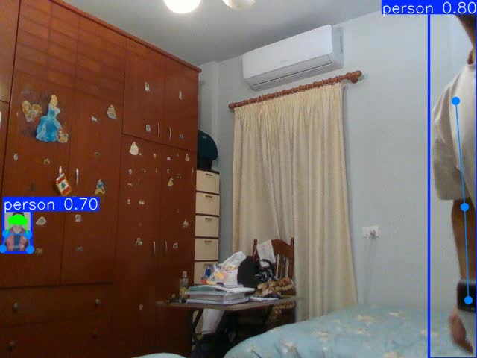
15

Slide 16
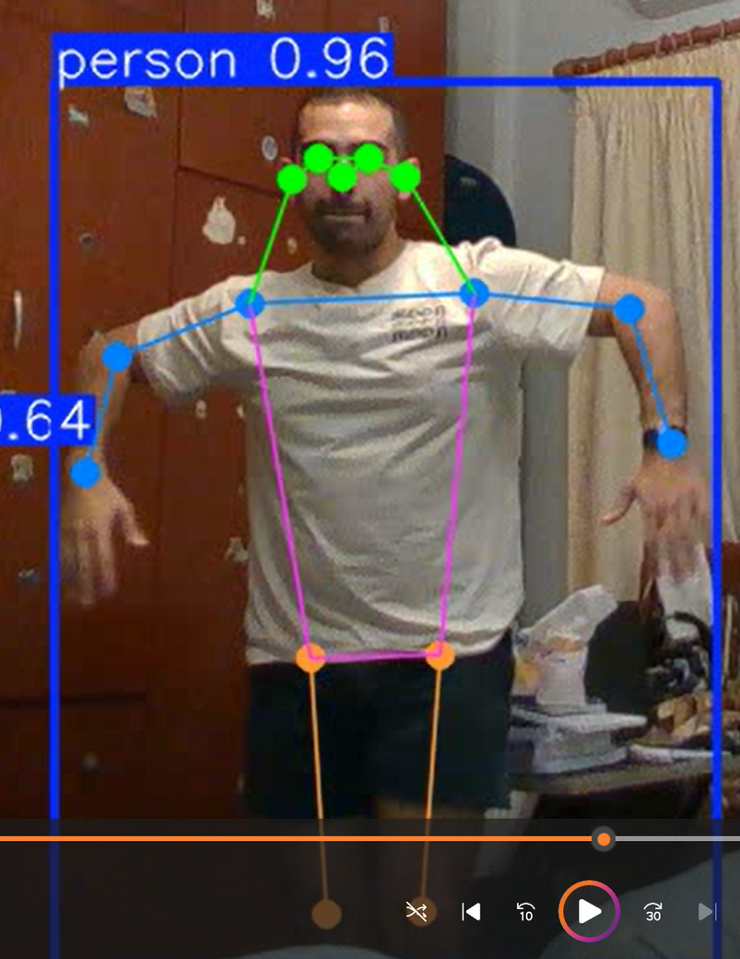
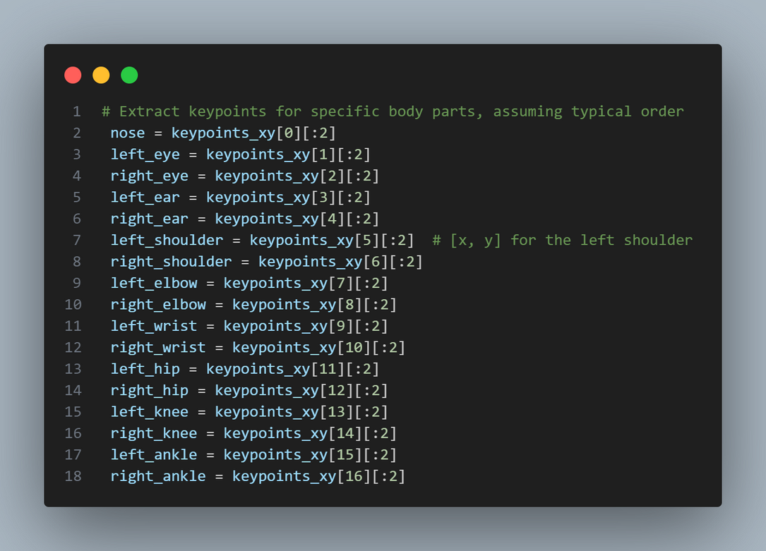
Keypoints
2
1
4
3
0
6
5
8
7
10
9
12
11
16

Slide 17
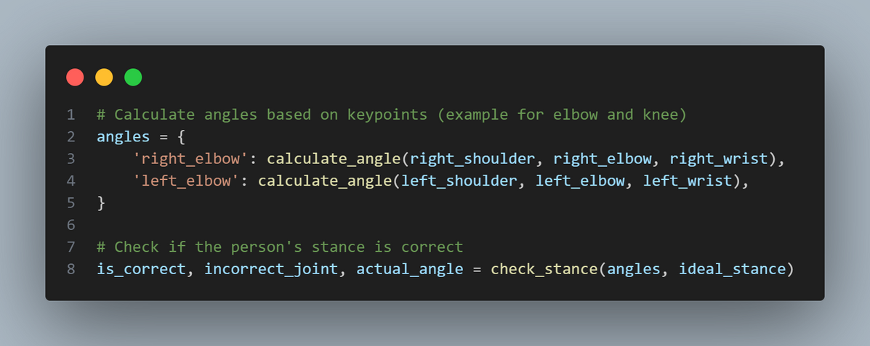
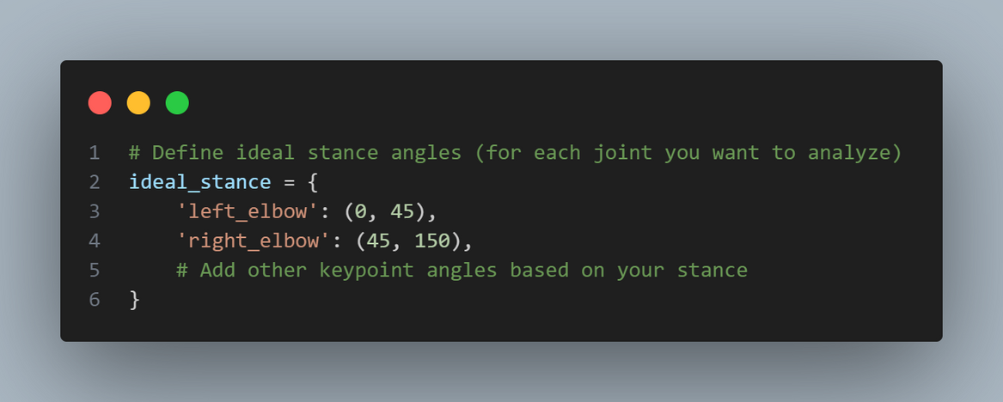
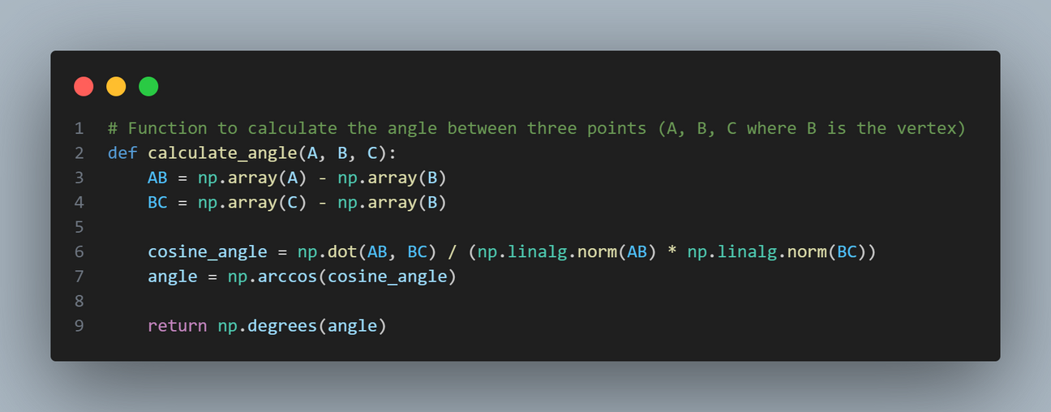
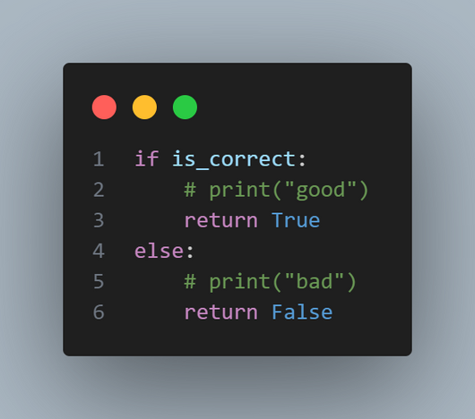
Key Utilities
17

Slide 18
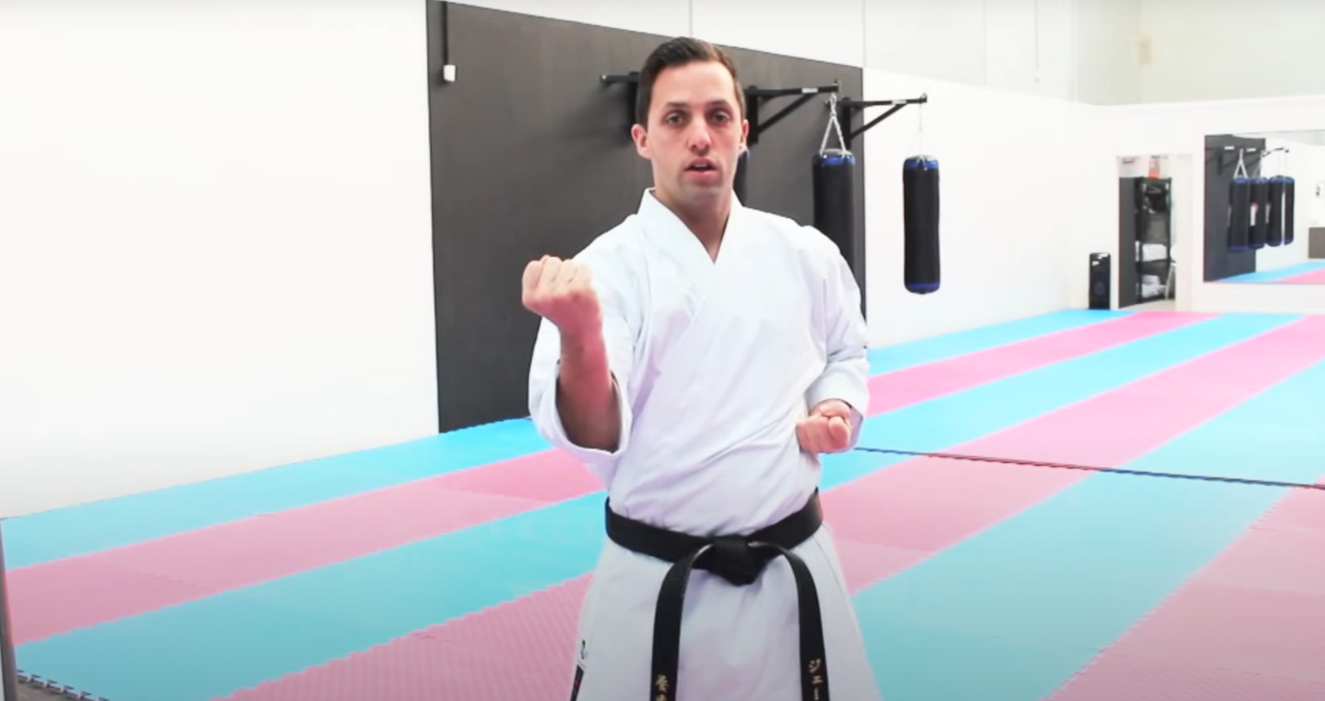
Before processing
18

Slide 19
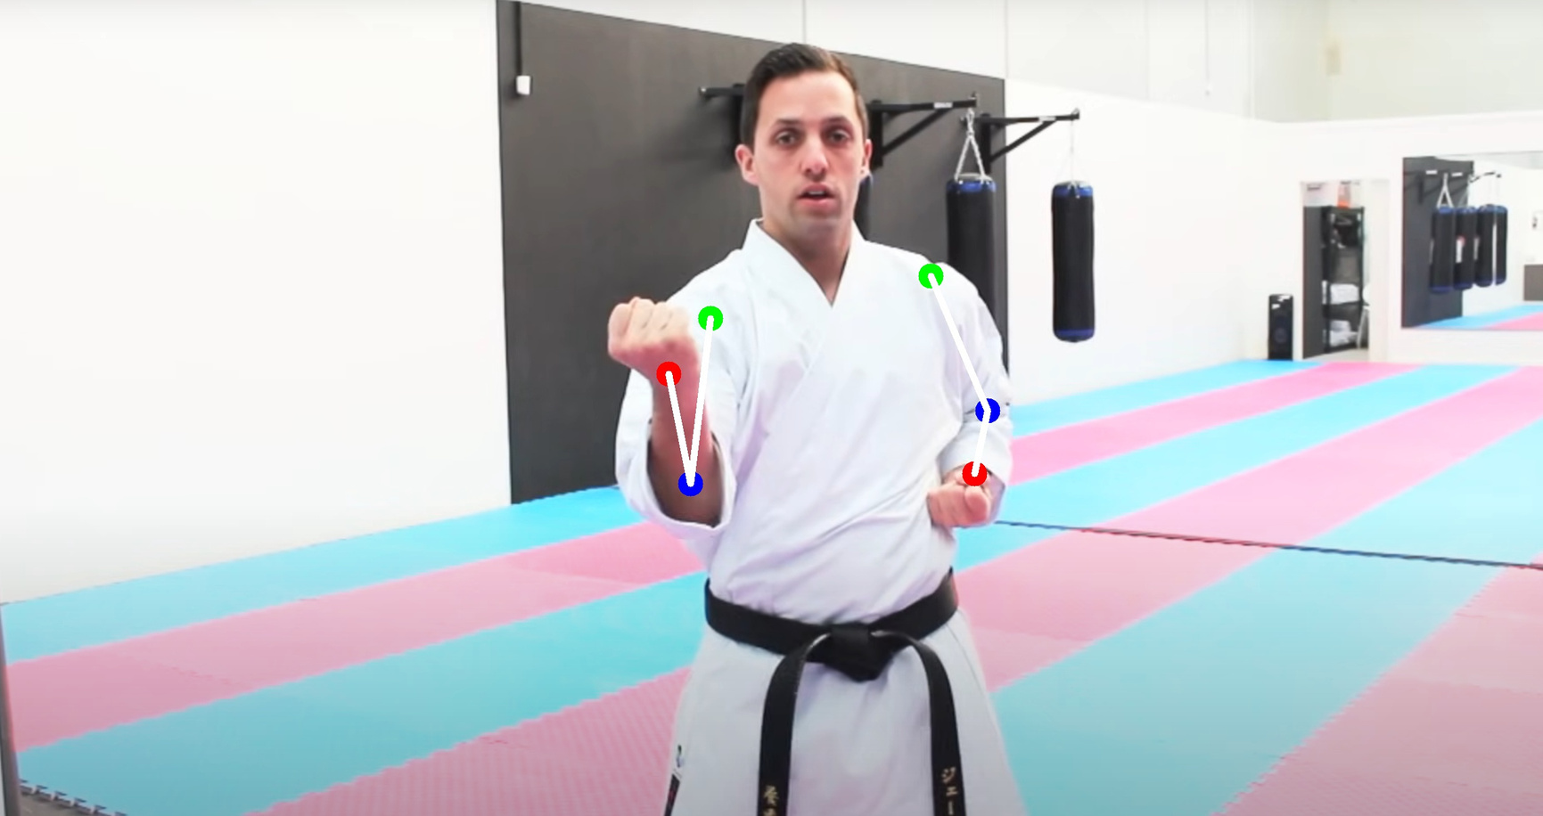
After processing
19

Slide 20
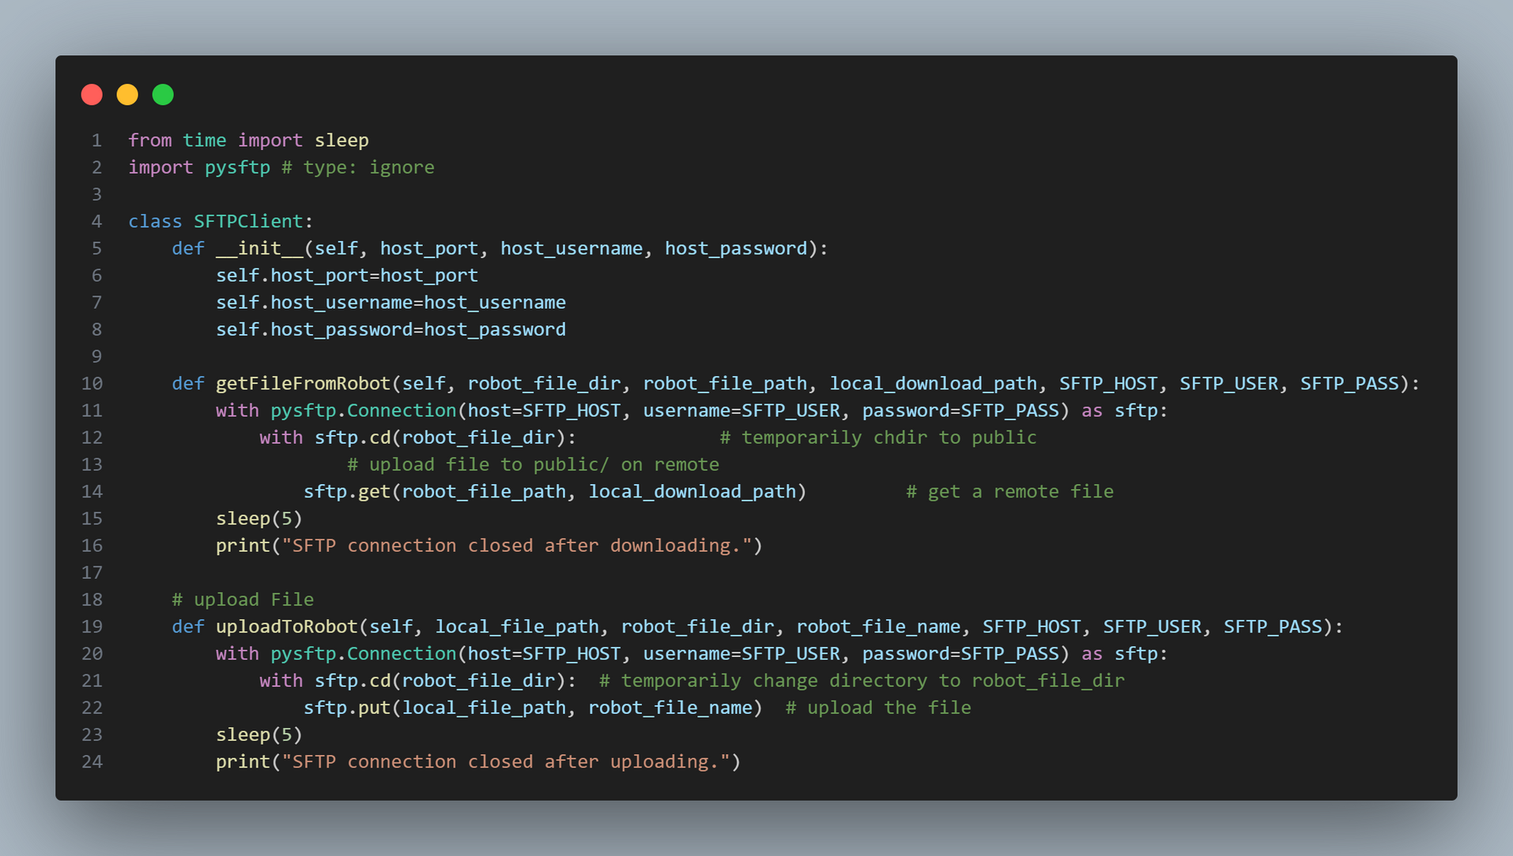
Secured File Transfer Protocol
20

Slide 21
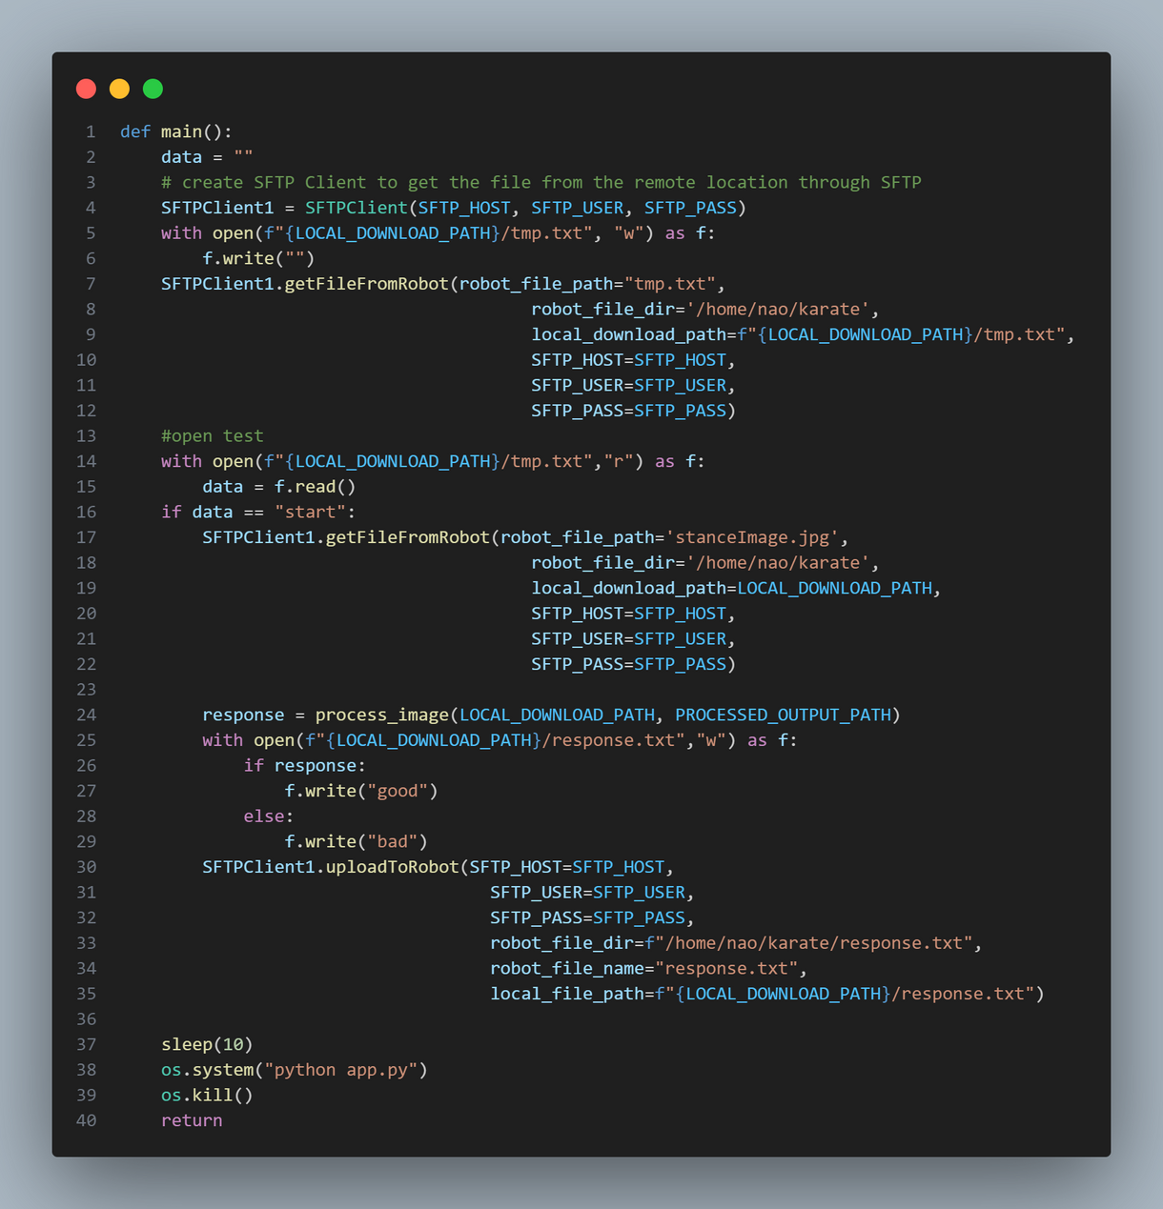
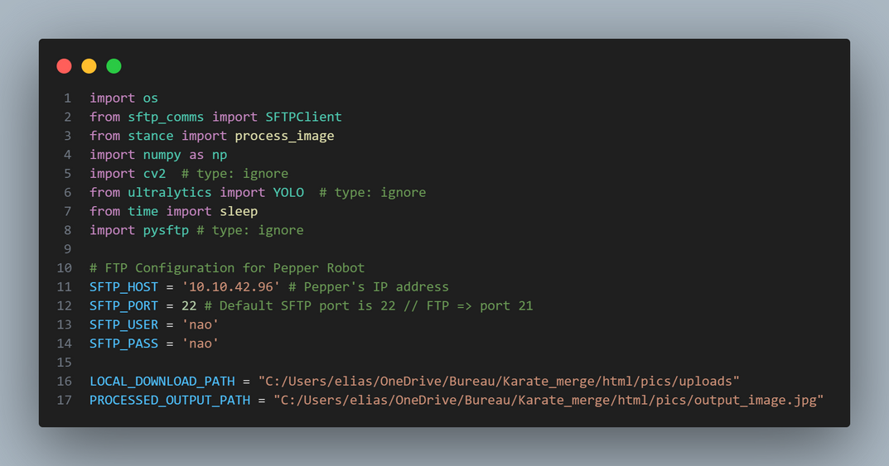
Our Script
21

Slide 22
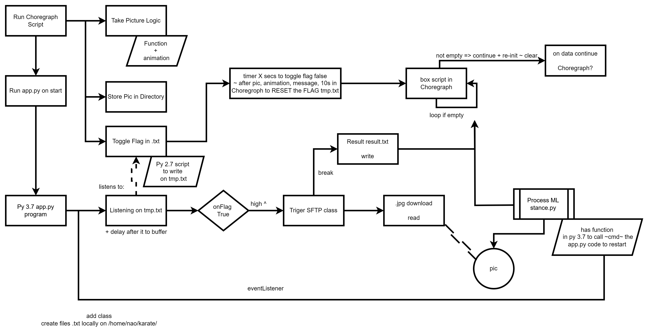
22

Slide 23
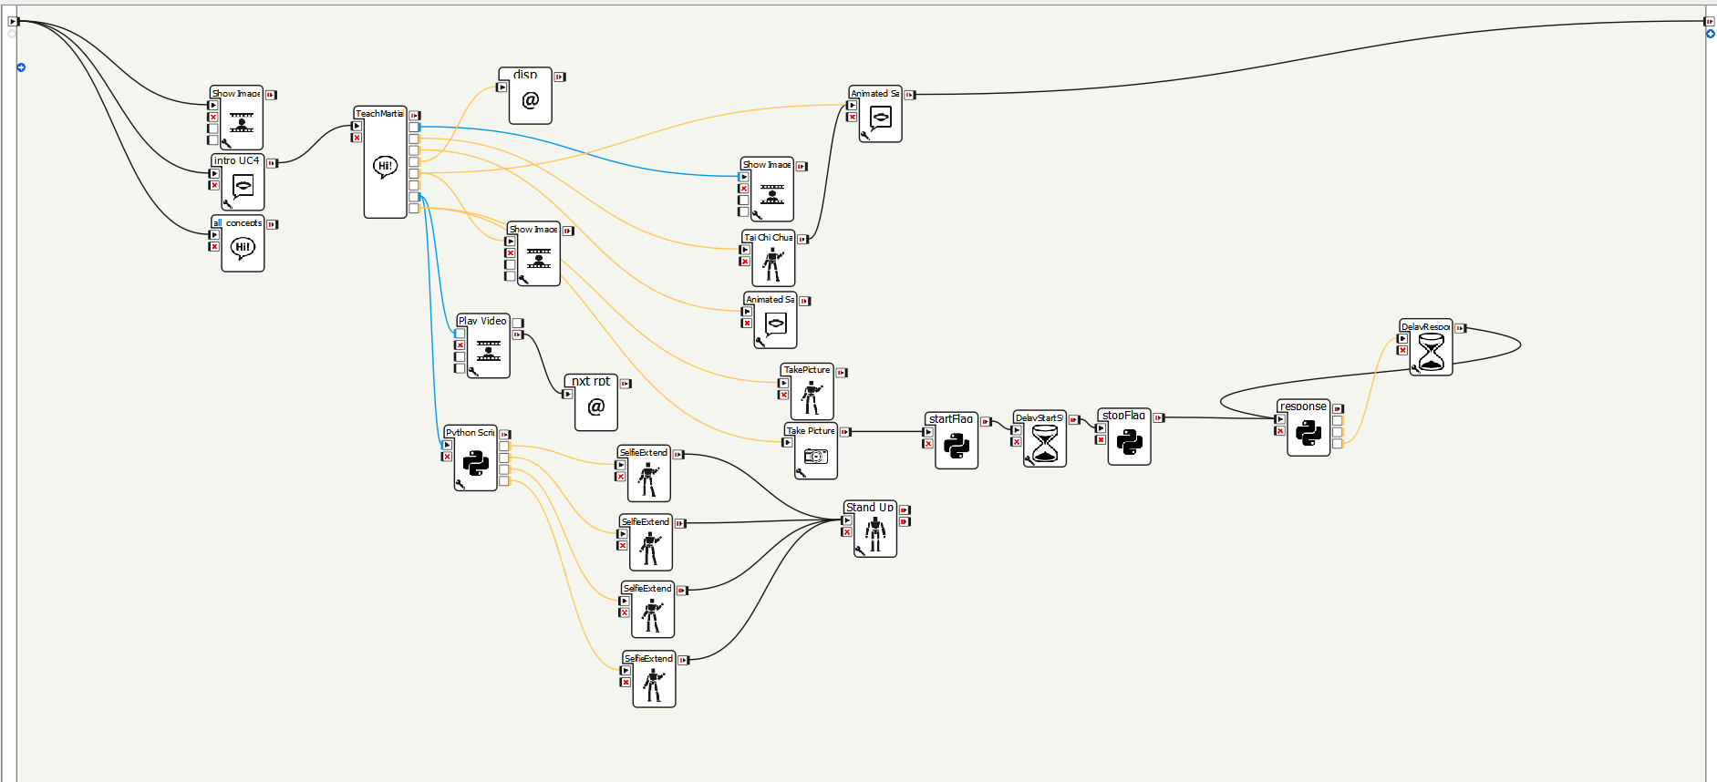
23

Slide 24


GIN456
Future Plans
Implement all the stances
Complete the project’s feedback design
Synchronize it correctly
PEPPER
24

Slide 25

Thank you !
25

